Slide 1
Pitfalls of Advance Directives in the Post-Acute Space
Tuesday, February 28, 2023 | 12:00 PM CT

Slide 2
The Good, The Bad and The Ugly
A Spaghetti Western ?
or Your Medical History ?
What Can You Do To Help Yourself ?
Mary Vigal JD, LL. M. Tax

Slide 3
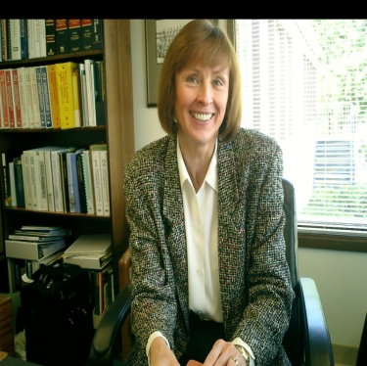
Mary Vigal, JD, LL.M. Tax
mary@condado-group.com
Tax Advice and Consulting – Former Professor LL.M. and MBA Tax programs Golden Gate University and Visiting Professor in Tax Santa Clara University School of Law
ABA Elder Law, Elder Abuse & Health Law Committees
Director with Survive a Stroke Foundation
www.surviveastroke.org

Slide 4
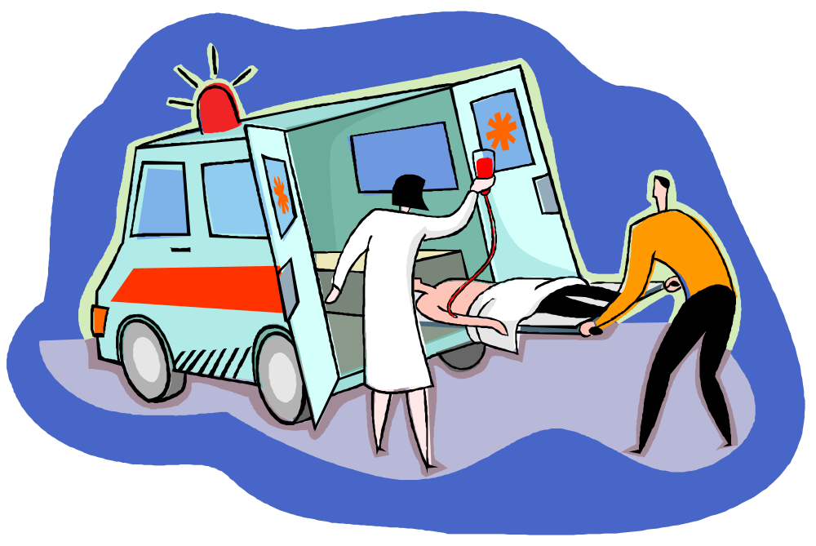
#1 The Good
Patient to ER
Advance Directive Durable
Health Care POA
Agent is with Patient
ER is saying DNR ?
Agent Says No ! Full Code !
ER repeats DNR ?

Slide 5

Advance Directives are Not DNRs
At any age, a medical emergency
can leave a person too ill to make
his or her own health care decisions.
Typically health care choices are
documented in living wills and/or
durable powers of attorney for
health care. These are referred to
as advance directives and are not
intended to be end of life instructions.
Often they are done as a part of an estate plan.
Notes:
Use verbs that describe the action you want the learner to take, according to the level of the program.
Beginner = lower level thinking
Intermediate = gradually higher
Advanced = highest level thinking
The next slide has verb suggestions from Bloom’s taxonomy.
Stay away from words open to many interpretations such as “know, understand, appreciate, grasp the significance of, believe, internalize, etc.”
E.g. At the conclusion of this program you will be able to “write, describe, identify, state, etc.”
E.g. “When faced with an ethical dilemma of taking on a new case adverse to a former client’s, you’ll be able to identify whether it is ‘substantially related’ enough to disqualify you from the case in accordance with MRPC 1.9.”

Slide 6
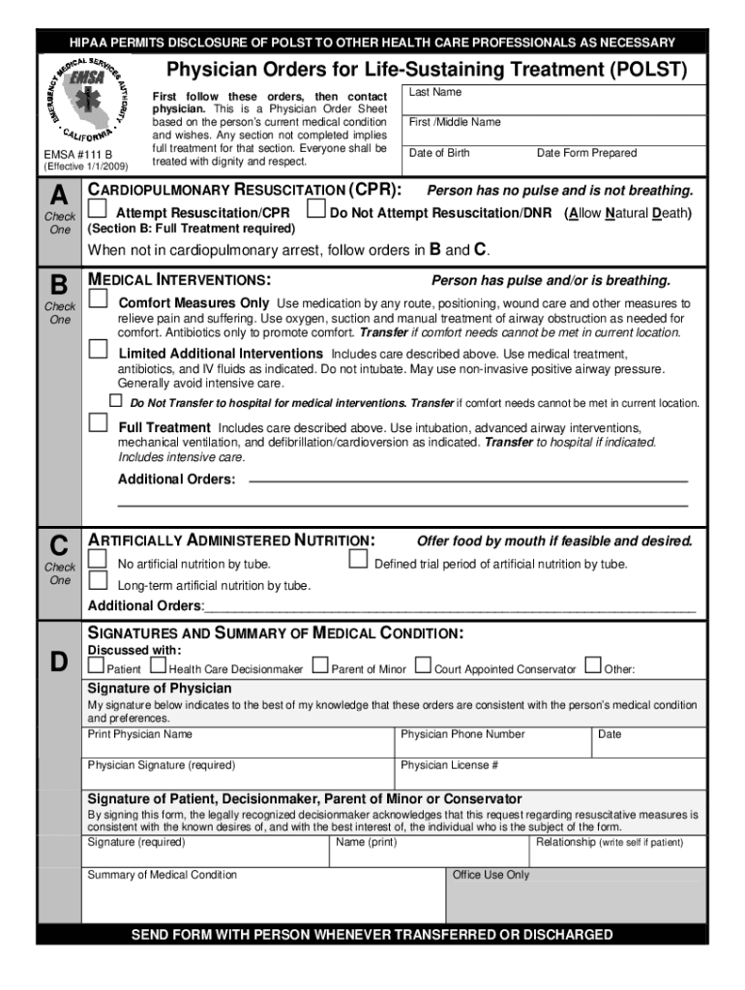

POLSTS are Not DNRs
The POLST is a medical order, not a legal
document. The POLST can become outdated
and produce the wrong life or death result.
If a POLST is not kept current or followed
correctly, a person’s wishes may evaporate
in a medical emergency.

Slide 7


#2 The Bad
Health Care agent can not be
there when medical decisions
are being made.
Medical Strangers are not always
interpreting legal documents
correctly or the documents leave
gaps.
Health Care agent wonders
what is happening ! ?

Slide 8



#3 The Ugly
No Phone Call to Health Care Agent?
No Transport to Another Facility ?
Patient illness prevents the patient from
voicing their medical choices now -
has to ”trust” the medical stranger.
Is this Informed Consent?
Hospital Release for patient now is
not back to home but to the morgue

Slide 9
1, 2, 3 Strikes You’re Out
You can prepare
Be Your Own Coach!*
Make Your Health Care Choices at the right time when you have the capacity to communicate and document your intent in your own words
What’s next then?
* From Sports Lead: www.surviveastroke.org

Slide 10

Sports Lead – Be Your own Coach
Learn About Medical
Emergencies Happen
Awareness of Medical
Develop a Plan
Be a Coach for Your
Medical !
Make it Fun – Get
Interested- Make it
Happen !
Only You Can Make
The Difference for
Yourself.
Contact Me If You
Need Ideas Before
Its Too Late

